Slide 1
For Two Stage Series Turbos as used on Renault R9M Gen2
1.6 litre Euro 5 & Euro 6b engines for Trafic/Vivaro/NV300 vehicles
IMPORTANT REPLACEMENT INFORMATION FOR HP AND LP TURBOS
LP turbos
Change 1:
821942- 0007, -0009, -0010 were all replaced by -0011. See page 3 for details of important changes.
Change 2:
Now replaced by 883861-5001S. This is a minor change. See pages 4 for details of this change.
HP turbos
821943-0002 & -0003. See page 5 for details.
Garrett Technical Bulletin Tech076 Revision B
Bulletin Revision Level | Date | Detail of changes:
B | 18/02/2020 | Corrected graphics to show exact turbos (pages 5 & 6) Corrected number of studs required and corrected gasket graphic (page 8) Corrected Gasket and Stud Kit part number (pages 3 & 8) Updated Euro emissions spec (page 1)
Note: Manufacturers names, models and numbers are shown in this bulletin for reference purposes only and do not imply that any part is the product of that manufacturer
Page 1
Bulletin Tech076

Slide 2
For Renault TwoStage Series Turbos
  Turbocharger identification
HP Turbo
Compressor connecting pipe
LP Turbo
Integrated exhaust manifold of HP turbo
Page 2
Bulletin Tech076

Slide 3
For Renault TwoStage Series Turbos
  Summary of changes to 821942-0011
    The turbine housing material of the LP turbocharger changed.
    At the same time the connecting studs of the HP turbo changed due to the different expansion rate of the LP housing new material.
It is vitally important to ensure that the correct HP turbo studs are used when installing a new LP turbo. Failure to do this will lead to loosening of the joint between the two turbos, with consequent exhaust gas leakage and the potential for turbo and vehicle damage and also fire.
  A new Gasket & Stud Kit, part number 901027-0001 is available to ensure that you use the correct studs
  Page 8 shows the correct replacement procedure
Page 3
Bulletin Tech076

Slide 4
For Renault TwoStage Series Turbos
  Summary of changes from 821942-0011 to 883861-0001
    Garrett internal - change of supplier for component only – no difference in turbocharger fit or performance
    883861-0001 is a Direct Service Replacement for 821942-0011
    When using 883861-0001 to replace 821942-0007, -0008 or -0010 the important notes on page 3 apply.
Page 4
Bulletin Tech076

Slide 5
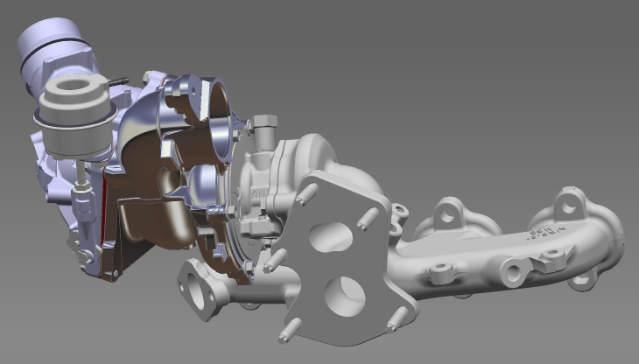
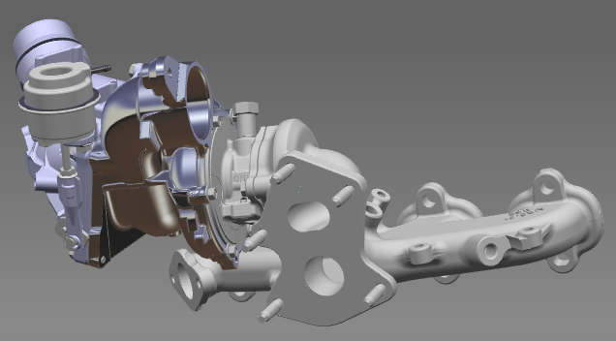
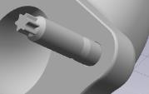
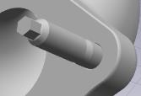
Old HP Turbo 821943-0002
Configuration of HP Turbos with manifold:
821943-0002 with Torx E7 studs 821943-0003 with Hexagon head studs
5 x studs with Torx E7 head
5 x studs with 5mm Hexagon head
*TBV flange
*TBV flange
New HP Turbo 821943-0003
*TBV = Turbine Bypass Valve
Page 5
Bulletin Tech076

Slide 6
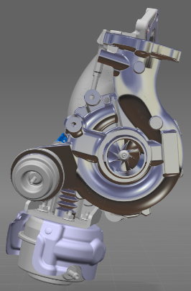
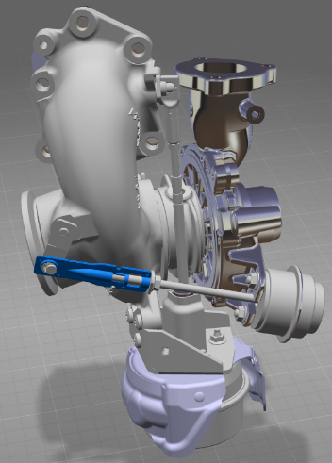
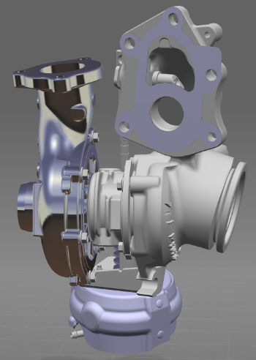
Configuration of LP Turbos:
821942- 0007, -0009, -0010 with old turbine housing material
821942-0011 & 883861-0001 with new turbine housing material
*TBV flange
5 x clearance holes for mounting studs of LP turbo
Note: all LP turbos look the same, so check part number from nameplate on compressor housing or check casting marks as shown on page 7
*TBV = Turbine Bypass Valve
Page 6
Bulletin Tech076

Slide 7
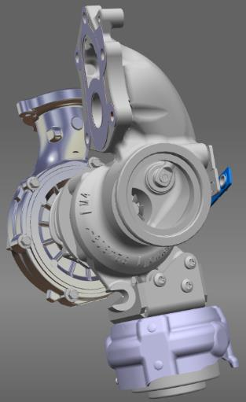
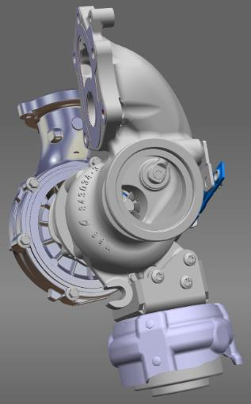
Identification of LP Turbos:
Left: 821942- 0007, -0009, -0010 with old turbine housing material
821942- 0007, -0009, -0010 with old turbine housing material
Turbine Housing casting mark for OLD material is “M4”
Turbine Housing casting mark for NEW material is “M68”
821942-0011 & 883861-0001 with new turbine housing material
Page 7
Bulletin Tech076

Slide 8


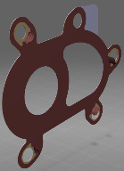
  IMPORTANT REPLACEMENT INFORMATION FOR HP AND LP TURBOS
  Please read the options below to decide how you must progress:
To replace both old turbos: | REMOVE OLD HP | AND | REMOVE OLD LP | Notes: New HP turbos include correct studs New LP turbos include new TBV gasket
 | 821943-0002 |  | 821942-0007, -0009, -0010
 | INSTALL NEW HP | AND | INSTALL NEW LP
 | 821943-5003S |  | 883861-5001S Includes new TBV gasket
To replace only the old LP turbo: | KEEP OLD HP |  | REMOVE OLD LP | Notes: Remove the 5 x Torx headed studs in the flange of the old HP turbo and replace them with the 5 x Hexagon head studs from the Stud and Gasket Kit before fitting the new LP turbo. Tighten studs to 12.0 – 17.0 Nm.
 | 821943-0002 |  | 821942-0007, -0009, -0010
 |  |  | INSTALL NEW LP
 |  |  | 883861-5001S Includes new TBV gasket
To replace only the old HP turbo: | REMOVE OLD HP |  | KEEP OLD LP | Notes: Remove the 5 x Hexagon headed studs in the flange from the new HP turbo and replace them with the 5 x Torx E7 head studs from the Stud and Gasket Kit before fitting the new HP turbo. Tighten studs to 12.0 – 17.0 Nm. Use new TBV gasket from kit.
 | 821943-0002 |  | 821942-0007, -0009, -0010
 | INSTALL NEW HP
 | 821943-5003S
Different head shape indicates different material
  Note: A new Gasket and Stud Kit, part number 901027-0001 is available to purchase separately.
  This includes: 5 x Studs with Torx E7 head + 5 x Studs with Hexagon head 5mm across flats + 1 x TBV gasket
  Do not use non-standard or incorrect studs on these installations for safety reasons. This would also void warranty.
TBV gasket
Page 8
Bulletin Tech076

